Slide 1
Mobile App Development with Xamarin and F#
Rachel Reese | @rachelreese | github: rachelreese

Slide 2


A mac Xamarin Studio Xamarin.iOS
Requirements
Notes:
Pair up if no Mac.

Slide 3
Agenda
1:00pm: Intro to Xamarin & F#
1:15pm: F# Basics Lab
1:30pm: MailboxProcessor
1:50pm: MailboxProcessor Lab
2:25pm: Break
2:35pm: iOS Basics – Project Lab
3:10pm: iOS Basics – UI Lab
3:45pm: Wrap-up, Show and Tell

Slide 4
Intro to Xamarin
Demo
Notes:
Go over
Types of projects you can create
How to get updates
Creating/Building a project
Show off StockTicker working.
sln files.
fsproj
open keyword
Show off REPL

Slide 5
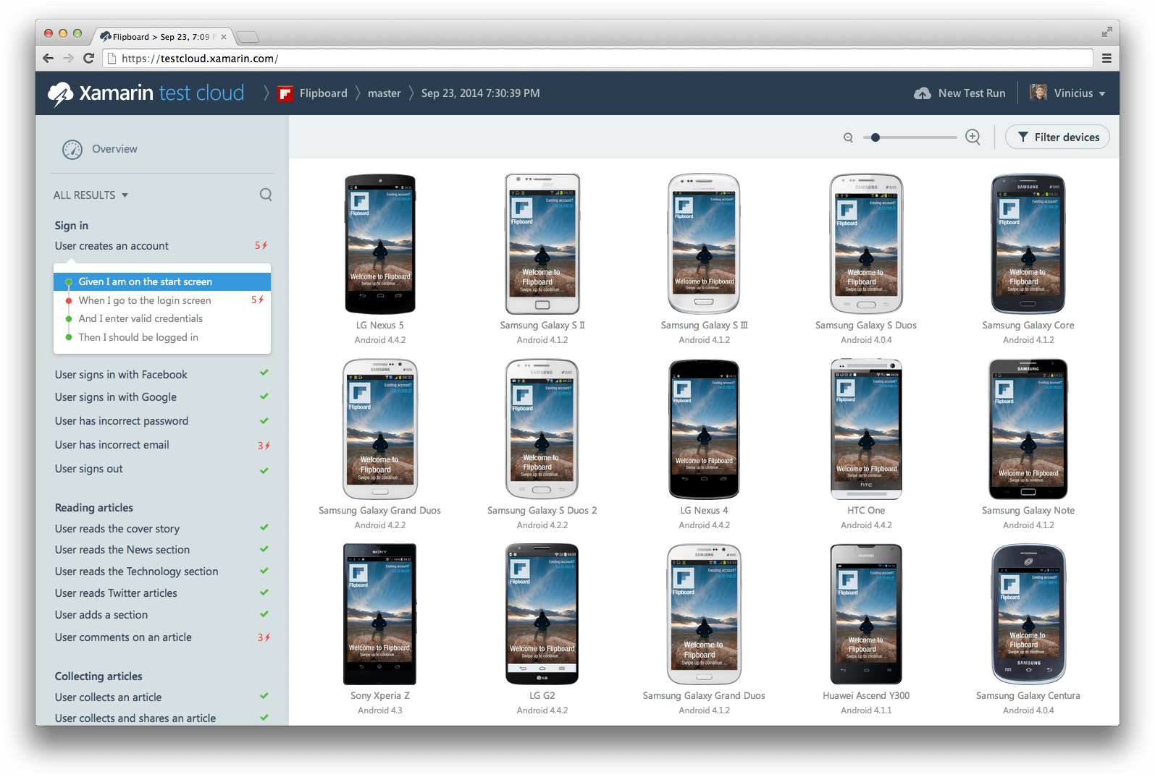
Xamarin Test Cloud

Slide 6
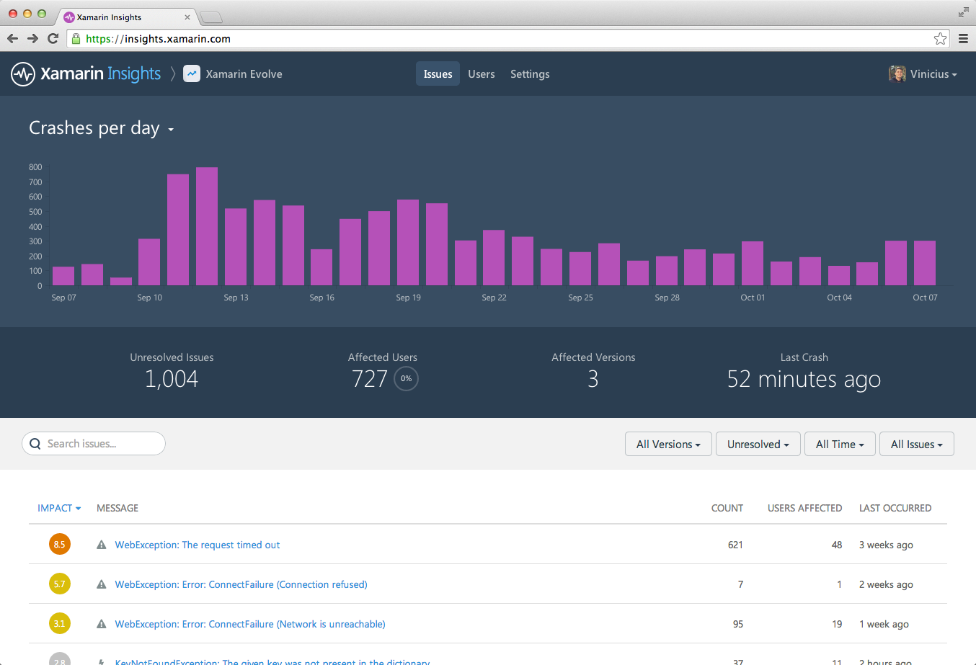
Xamarin Insights
Notes:
Real-time monitoring.

Slide 7
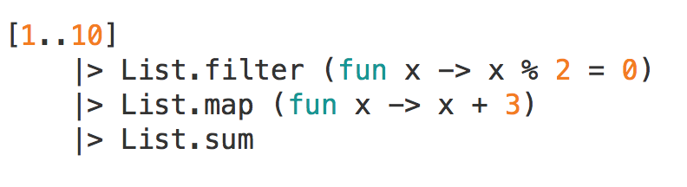
F# Basics
Immutable
Significant whitespace
Pipelining
Higher-order functions
Tuples
Option types
Notes:
Pipelining
like unix shell scripting or powershell.
Stolen by R, Elixir, OCaml. :D
Options:
Similar to nullable<int> but different because:
Can be used on any type (strings, functions)
When pattern matched on, forces you to consider None case
Can use map, iter, etc. functions.
Nestable: Option<Option<int>> is valid.

Slide 8
F# Basics
Demo
Notes:
Show off sketch files
Show off script files w/ REPL

Slide 9
F# Sketches Lab
File -> New -> File -> Sketches -> Xamarin.Mac.Sketch
Suggested tasks:
Add two numbers.
Given a list of floats from 0 to 30, return only those numbers divisible by 3.
Using System.Random, generate a random number.
Create a Discriminated Union and a function that pattern matches on it.
Syntax cheat sheets:
http://dungpa.github.io/fsharp-cheatsheet/
http://www.samskivert.com/code/fsharp/fsharp-cheat-sheet.pdf
https://msdn.microsoft.com/en-us/library/dd233181.aspx
http://en.wikibooks.org/wiki/F_Sharp_Programming

Slide 10
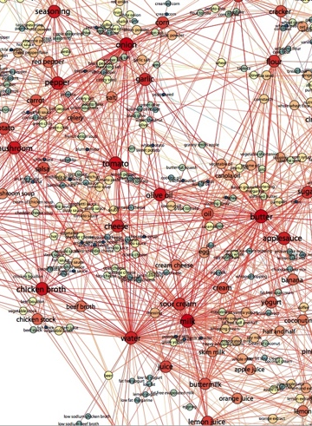
Mailbox Processor
F#’s implementation of the Actor Model

Slide 11

The Actor Model
Concurrency model where interaction is through direct, asynchronous message-passing
An actor is an independent computational entity which contains a queue, and receives and processes messages.
One actor is no actor. They come in systems.

Slide 12
MailboxProcessor Basics
Demo

Slide 13
MailboxProcessor Lab: Faking the stock data with agents
Create an agent which accepts messages of type float.
When a message is received, the agent should:
Use System.Random to generate a random number which modifies the float by a small amount
Use printfn to write the new number to the console
Modify the agent to:
Accept messages of ReplyChannel instead of float, which should respond during each loop with the new value that has been calculated
Add a parameter, price, to your agent. This will tell your agent where to start looping, since you’re not posting a float in your message.

Slide 14

10-minute Break

Slide 15
Agenda
1:00pm: Intro to Xamarin & F#
1:15pm: F# Basics Lab
1:30pm: MailboxProcessor
1:50pm: MailboxProcessor Lab
2:25pm: Break
2:35pm: iOS Basics – Project Lab
3:10pm: iOS Basics – UI Lab
3:45pm: Show & Tell

Slide 16
iOS Basics – Project
Let’s create a basic iOS project together.
Notes:
Create iOS project together.
AppDelegate (don’t need to change anything, today). App lifecycle.
Controller (ViewDidLoad, ViewWillLoad, etc.) Page lifecycle.
Can’t build project: must switch from iOS device.
Mention namespaces and modules.
Add new UIView(this.View.Bounds) → discuss frames and RectangleF, but use this.View.Bounds
Show off intellisense, but bring back to main declaration to be functional
Add view as subview to main view.

Slide 17
iOS: Enhance your project
Create a new .fs file for your agent, and add:
Your agent code.
Three instances of your agent, for three different stocks (Microsoft, Google, Apple).
In your ViewController, add a new function which:
Posts to your agent and receives a reply
Prints the response to the console with the name of the stock, the new value, and the number of times the function has recursed.
In ViewDidLoad:
Call this function three times (once for each stock)
Add a UILabel that says “Hello world” in Red.
Build and run your project!

Slide 18
iOS Basics – UI
Let’s add charting!
Notes:
Browse to Xamarin’s component store: http://components.xamarin.com/ and download the TeeChart Charting Library trial.
Unzip the project, and add a reference to the iOS dll:
Right-click References -> Edit References -> .NET Assembly -> Browse

Slide 19
iOS: Add a multi-line chart!
In ViewDidLoad, create a new Chart
Make sure to add a frame to display it!
Delete your Hello world UILabel
Create an individual line for each stock you have created.
Use: Styles.FastLine() for TeeChart
Make sure to label each line in the chart key
Add each line to the chart you created
Once you receive back the updated stock price from your agent, add this new value to your line
If you receive warnings writing this code, it’s okay to pipe the result of your code in each place to “ignore”, or just to ignore the warnings
BONUS: If you have time, add a UISegmentedControl to Stop/Start the agents at will.

Slide 20
Show & Tell!

Slide 21
Mobile App Development with Xamarin and F#
Rachel Reese | @rachelreese | github: rachelreese

